Slide 1
Database Fundamentals

Slide 2
A Database Schema
Schema Owner
[1]
Tables
Indexes
Procedures
Views
Constraints
schema objects
1) Stephens, R.K. and Plew. R.R., 2001. Database Design. SAMS, Indianapolis , IN. (with slight changes by V.G.D.)

Slide 3
Caution about Schema Objects
The meaning of “object” here is different than that in UML.

Slide 4
Table
“A table is the primary unit of physical storage for data in a database.”¹
Usually a database contains more than one table.
1) Stephens, R.K. and Plew. R.R., 2001. Database Design. SAMS, Indianapolis , IN.

Slide 5
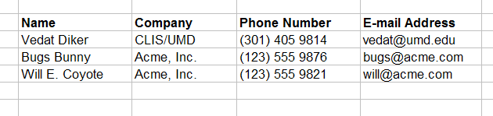
Table

Slide 6
A Database with Multiple Tables
[1]
Publishers
Books
Customers
Authors
Inventory
Orders
1) Stephens, R.K. and Plew. R.R., 2001. Database Design. SAMS, Indianapolis , IN. (with slight changes by V.G.D.)

Slide 7
Table
Customers

Slide 8
Field (Column)
Customers
a field

Slide 9
Record (Row)
Customers
a record

Slide 10
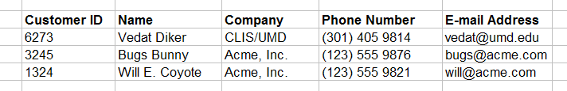
Primary Key
Customers
primary key field
Primary key is a unique identifier of records in a table.
Primary key values may be generated manually or automatically.

Slide 11
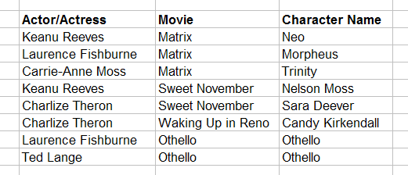
Primary Key
Roles (Performances)
primary key fields
A primary key can consist of more than one field.

Slide 12
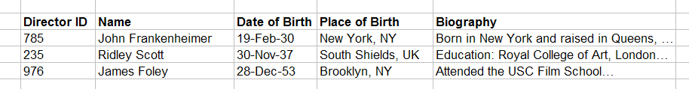
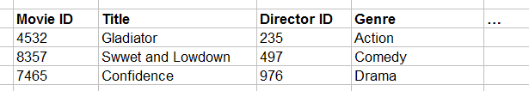
Foreign Key
primary key field
parent table
Directors
relationship
child table
Movies
foreign key field

Slide 13
Relationship Types
One-to-one
One-to-many
Many-to-many

Slide 14
Data Types
Alphanumeric (Text, Memo)
Numeric (Number, Currency, etc.)
Date/Time
Boolean (Yes/No)

Slide 15
Entity
“An entity is a business object that represents a group, or category of data.”¹
Do we know a similar concept?
1) Stephens, R.K. and Plew. R.R., 2001. Database Design, pp. 21. SAMS, Indianapolis , IN.

Slide 16
Instance (Record, Tuple)
“A single, specific occurrence of an entity is an instance. Other terms for an instance are record and tuple.”¹
Do we know a similar concept?
1) Stephens, R.K. and Plew. R.R., 2001. Database Design, pp. 210. SAMS, Indianapolis , IN.

Slide 17
Attribute
“An attribute is a sub-group of information within an entity.”¹
Do we know a similar concept?
1) Stephens, R.K. and Plew. R.R., 2001. Database Design, pp. 21. SAMS, Indianapolis , IN.

Slide 18
Relationship
A relationship is a link that relates two entities that share one or more attributes.
Do we know a similar concept?

Slide 19
OO Design → DB Design
Class → Entity (Table)
Object → Record
Attribute → Attribute (Field)
Association → Relationship
…

Slide 20
Database Environments
Mainframe
Client/Server
Internet-based

Slide 21
Database Types
Flat-file
Hierarchical
Network
Relational
Object-oriented
Object-relational

Slide 22
Normalization
(Advanced – may not be required for LBSC690)

Slide 23
Normalization
A method for organizing data elements into tables.
Done in order to avoid
  Duplication of data
  Insert anomaly
  Delete anomaly
  Update anomaly

Slide 24
We will look at
First Normal Form
Second Normal Form
Third Normal Form

Slide 25
Example (Unnormalized)
Table: SalesOrders (Un-normalized)
      SalesOrderNo
      Date
      CustomerNo
      CustomerName
      CutomerAddress
      ClerkNo
      ClerkName
      Item1Description
      Item1Quantity
      Item1UnitPrice
      Item2Description
      Item2Quantity
      Item2UnitPrice
      Item3Description
      Item3Quantity
      Item3UnitPrice
      Total

Slide 26
Normalize into 1NF
Separate repeating groups into new tables.
Start a new table for the repeating data.
The primary key for the repeating group is usually a composite key.

Slide 27
Example (1NF)
Table: SalesOrders
      SalesOrderNo
      Date
      CustomerNo
      CustomerName
      CustomerAddress
      ClerkNo
      ClerkName
      Total
Table: OrderItems
      SalesOrderNo
      ItemNo
      ItemDescription
      ItemQuantity
      ItemUnitPrice

Slide 28
Normalize into 2NF
Remove partial dependencies.
Start a new table for the partially dependent data and the part of the key it depends on.
Tables started at this step usually contain descriptions of resources.

Slide 29
Dependencies
Functional dependency: The value of one attribute depends entirely on the value of another.
Partial dependency: An attribute depends on only part of the primary key. (The primary key must be a composite key.)
Transitive dependency: An attribute depends on an attribute other than the primary key.

Slide 30
Example (2NF)
Table: OrderItems
      SalesOrderNo
      ItemNo
      ItemQuantity
      ItemUnitPrice
Table: InventoryItems
      ItemNo
      ItemDescription

Slide 31
What if we did not do 2NF
Duplication of data: ItemDescription would appear for every order.
Insert anomaly: To insert an inventory item, you must insert a sales order.
Delete anomaly: Information about the items stay with sales order records. Delete a sales order record, delete the item description.
Update anomaly: To change an item description, you must change all the sales order records that have the item.

Slide 32
Normalize into 3NF
Remove transitive dependencies.
Start a new table for the transitively dependent attribute and the attribute it depends on.
Keep a copy of the key attribute in the original table.

Slide 33
Example (3NF)
Table: SalesOrders
      SalesOrderNo
      Date
      CustomerNo
      ClerkNo
      Total
Table: Customers
      CustomerNo
      CustomerName
      CustomerAddress
Table: Clerks
      ClerkNo
      ClerkName

Slide 34
What if we did not do 3NF
Duplication of data: Customer and Clerk details would appear for every order.
Insert anomaly: To insert a customer or clerk, you must insert a sales order.
Delete anomaly: Information about the customers and clerks stay with sales order records. Delete a sales order record, delete the customer or clerk.
Update anomaly: To change the details of a customer or clerk, you must change all the sales order records that involve that customer or clerk.

Slide 35
Example (Final Tables)
Table: SalesOrders
      SalesOrderNo
      Date
      CustomerNo
      ClerkNo
      Total
Table: OrderItems
      SalesOrderNo
      ItemNo
      ItemQuantity
      ItemUnitPrice
Table: InventoryItems
      ItemNo
      ItemDescription
Table: Customers
      CustomerNo
      CustomerName
      CustomerAddress
Table: Clerks
      ClerkNo
      ClerkName

